Slide 1

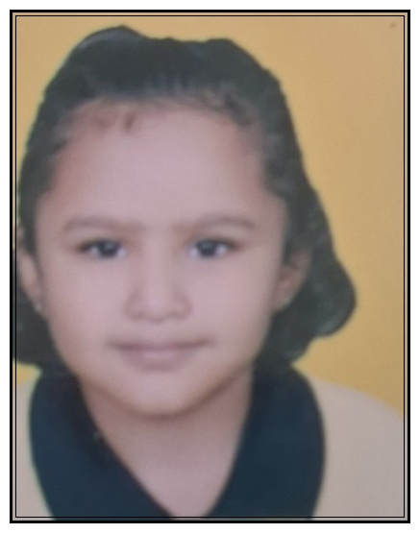
MAHESHWARI PRAGATI MANDAL
MALAD SAMITIES
MALAD UTSAV 2025
⭐⭐⭐⭐⭐
DHRUVI DHOOT
⭐⭐⭐⭐⭐
Parent Name: KUSHAL DHOOT
School Name: ORCHID THE INTERNATIONAL SCHOOL
Grade Standard: Jr KG

Slide 2
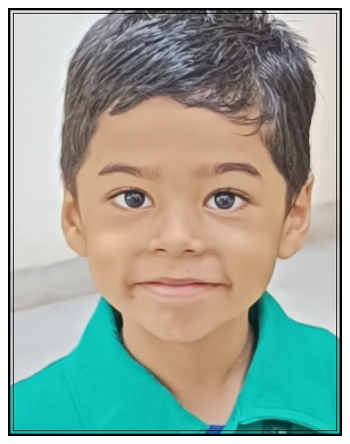
MAHESHWARI PRAGATI MANDAL
MALAD SAMITIES
MALAD UTSAV 2025
⭐⭐⭐⭐⭐
HARSHAL MAHESHWARI
⭐⭐⭐⭐⭐
Parent Name: NIKHIL MAHESHWARI
School Name: CHILDREN'S ACADEMY
Grade Standard: Jr KG

Slide 3
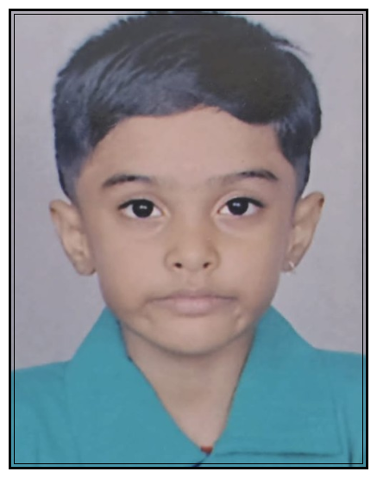
MAHESHWARI PRAGATI MANDAL
MALAD SAMITIES
MALAD UTSAV 2025
⭐⭐⭐⭐⭐
MRUNAL LADDHA
⭐⭐⭐⭐⭐
Parent Name: RUPALI PUSHPAK LADDHA
School Name: CHILDREN'S ACADEMY
Grade Standard: Jr KG

Slide 4
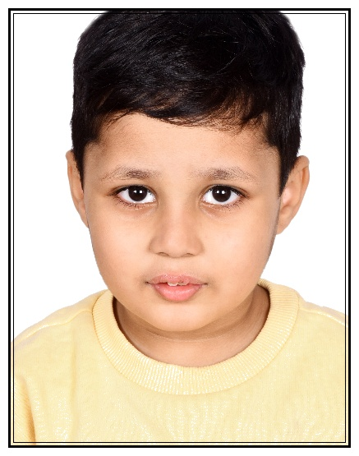
MAHESHWARI PRAGATI MANDAL
MALAD SAMITIES
MALAD UTSAV 2025
⭐⭐⭐⭐⭐
NEEV MAHESHWARI
⭐⭐⭐⭐⭐
Parent Name: AARTI MAHESHWARI
School Name: TINY TOTS
Grade Standard: Jr KG

Slide 5
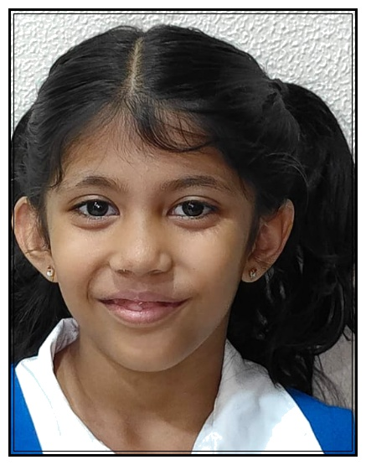
MAHESHWARI PRAGATI MANDAL
MALAD SAMITIES
MALAD UTSAV 2025
⭐⭐⭐⭐⭐
AVEESHA BHALA
⭐⭐⭐⭐⭐
Parent Name: ANUJ BHALA
School Name: LOKHANDWALA FOUNDATION SCHOOL
Grade Standard: Sr KG

Slide 6
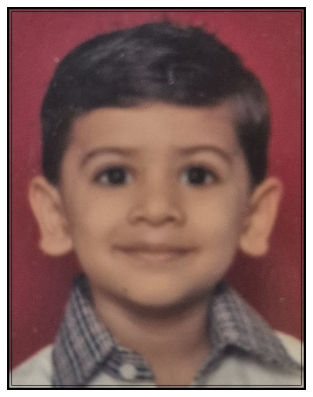
MAHESHWARI PRAGATI MANDAL
MALAD SAMITIES
MALAD UTSAV 2025
⭐⭐⭐⭐⭐
KRIYANSH MALPANI
⭐⭐⭐⭐⭐
Parent Name: PRIYANKA MALPANI
School Name: RAMNIWAS BAJAJ ENGLISH HIGH SCHOOL
Grade Standard: Sr KG

Slide 7
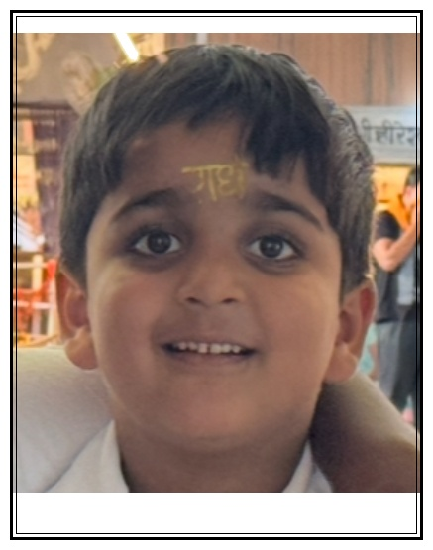
MAHESHWARI PRAGATI MANDAL
MALAD SAMITIES
MALAD UTSAV 2025
⭐⭐⭐⭐⭐
PRANAY JAJOO
⭐⭐⭐⭐⭐
Parent Name: JYOTI JAJOO
School Name: THAKUR PUBLIC SCHOOL
Grade Standard: Sr KG

Slide 8
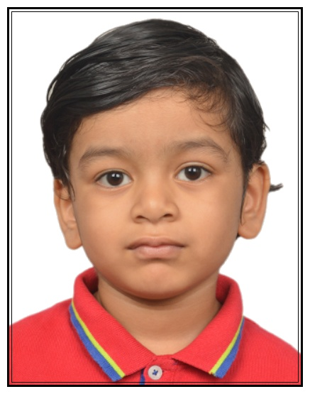
MAHESHWARI PRAGATI MANDAL
MALAD SAMITIES
MALAD UTSAV 2025
⭐⭐⭐⭐⭐
ARJUN RAHUL ASSAWA
⭐⭐⭐⭐⭐
Parent Name: RAHUL & SUCHIKA ASSAWA
School Name: D G KHETAN INTERNATIONAL SCHOOL
Grade Standard: I

Slide 9
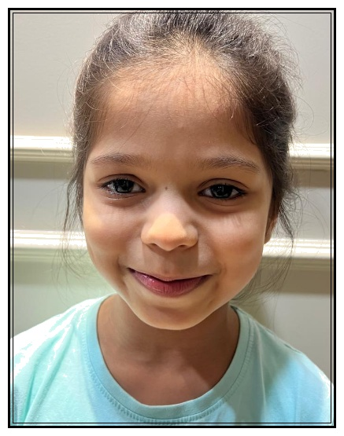
MAHESHWARI PRAGATI MANDAL
MALAD SAMITIES
MALAD UTSAV 2025
⭐⭐⭐⭐⭐
DIA RATHI
⭐⭐⭐⭐⭐
Parent Name: ABHISHEK RATHI
School Name: GUNDECHA EDUCATION ACADEMY
Grade Standard: I

Slide 10
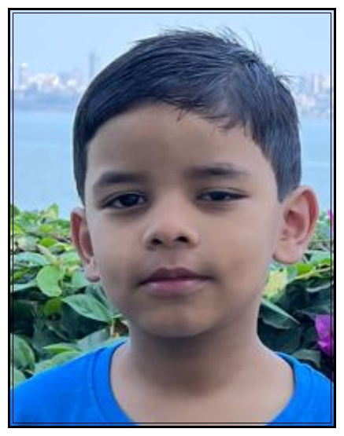
MAHESHWARI PRAGATI MANDAL
MALAD SAMITIES
MALAD UTSAV 2025
⭐⭐⭐⭐⭐
JISHAAN GAGGAR
⭐⭐⭐⭐⭐
Parent Name: DEEPALI AND RAMAVTAR GAGGAR
School Name: VIBGYOR ROOTS AND RISE
Grade Standard: I

Slide 11
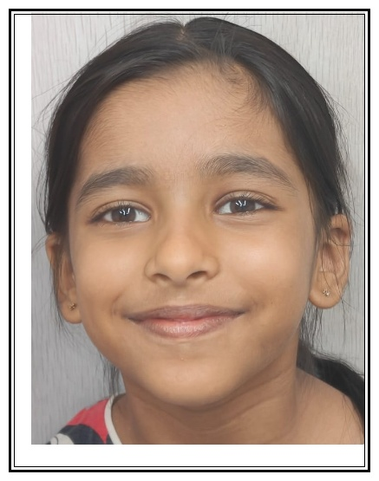
MAHESHWARI PRAGATI MANDAL
MALAD SAMITIES
MALAD UTSAV 2025
⭐⭐⭐⭐⭐
KHYATI BHAIYYA
⭐⭐⭐⭐⭐
Parent Name: ASHISH POONAM BHAIYYA
School Name: ST. JOHN UNIVERSAL SCHOOL
Grade Standard: I

Slide 12
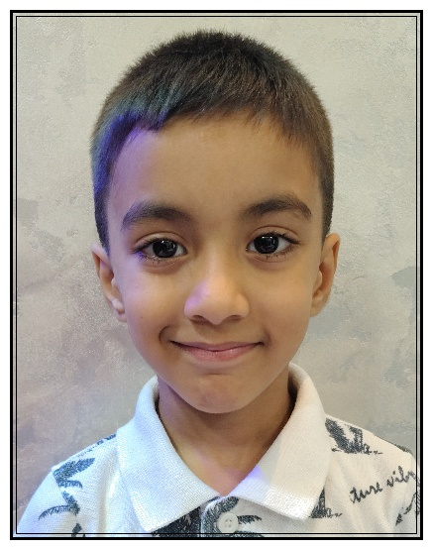
MAHESHWARI PRAGATI MANDAL
MALAD SAMITIES
MALAD UTSAV 2025
⭐⭐⭐⭐⭐
MAANVIK BHOOTRA
⭐⭐⭐⭐⭐
Parent Name: HARISH BHOOTRA
School Name: CHILDREN'S ACADEMY
Grade Standard: I

Slide 13
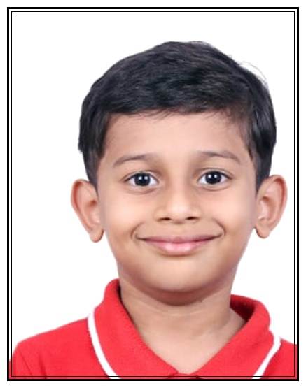
MAHESHWARI PRAGATI MANDAL
MALAD SAMITIES
MALAD UTSAV 2025
⭐⭐⭐⭐⭐
NAITIK NILESH TAWARI
⭐⭐⭐⭐⭐
Parent Name: NILESH TAWARI
School Name: D G KHETAN INTERNATIONAL SCHOOL
Grade Standard: I

Slide 14
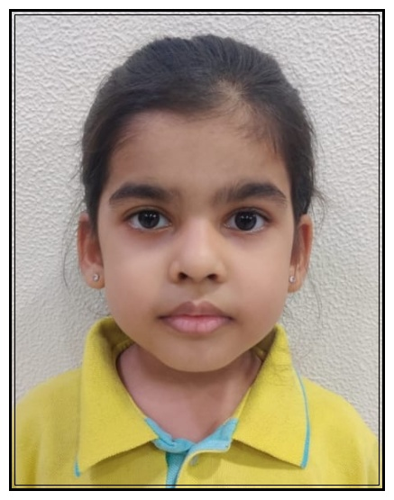
MAHESHWARI PRAGATI MANDAL
MALAD SAMITIES
MALAD UTSAV 2025
⭐⭐⭐⭐⭐
PARIDHI MAHENDRA RATHI
⭐⭐⭐⭐⭐
Parent Name: MAHENDRA MADANMOHAN RATHI
School Name: D G KHETAN INTERNATIONAL SCHOOL
Grade Standard: I

Slide 15
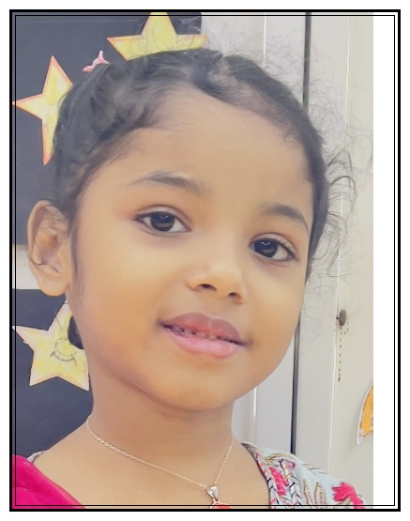
MAHESHWARI PRAGATI MANDAL
MALAD SAMITIES
MALAD UTSAV 2025
⭐⭐⭐⭐⭐
PRISHA TOSHNIWAL
⭐⭐⭐⭐⭐
Parent Name: MAYURKUMAR TOSHNIWAL
School Name: VIBGYOR ROOTS AND RISE
Grade Standard: I

Slide 16
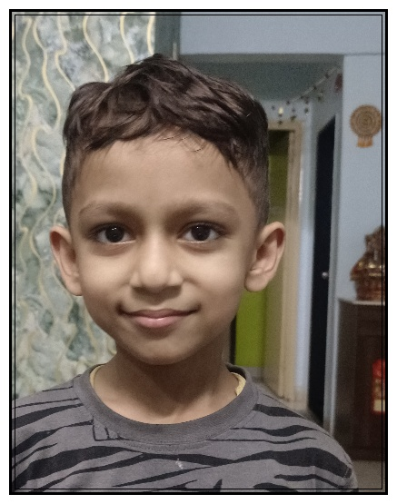
MAHESHWARI PRAGATI MANDAL
MALAD SAMITIES
MALAD UTSAV 2025
⭐⭐⭐⭐⭐
SHREYANSH DAGA
⭐⭐⭐⭐⭐
Parent Name: ADITYA DAGA
School Name: GUNDECHA EDUCATION ACADEMY
Grade Standard: I

Slide 17
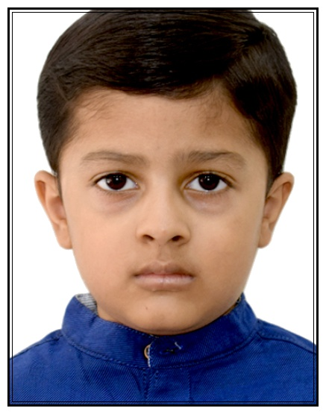
MAHESHWARI PRAGATI MANDAL
MALAD SAMITIES
MALAD UTSAV 2025
⭐⭐⭐⭐⭐
YUVANSH MALPANI
⭐⭐⭐⭐⭐
Parent Name: SACHIN MALPANI
School Name: VIBGYOR ROOTS AND RISE
Grade Standard: I

Slide 18
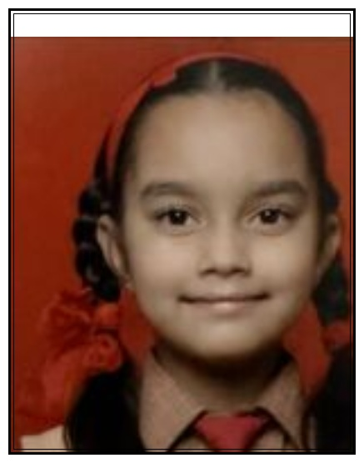
MAHESHWARI PRAGATI MANDAL
MALAD SAMITIES
MALAD UTSAV 2025
⭐⭐⭐⭐⭐
AHANA RATHI
⭐⭐⭐⭐⭐
Parent Name: HARSHIT RATHI
School Name: CAMBRIDGE SCHOOL
Grade Standard: II

Slide 19
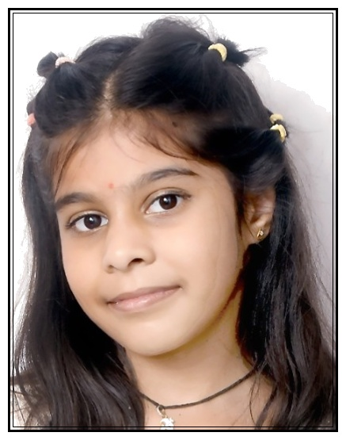
MAHESHWARI PRAGATI MANDAL
MALAD SAMITIES
MALAD UTSAV 2025
⭐⭐⭐⭐⭐
CHAHAL ASHISH SODANI
⭐⭐⭐⭐⭐
Parent Name: ASHISH KUMAR SODANI
School Name: CHILDREN'S ACADEMY
Grade Standard: II

Slide 20
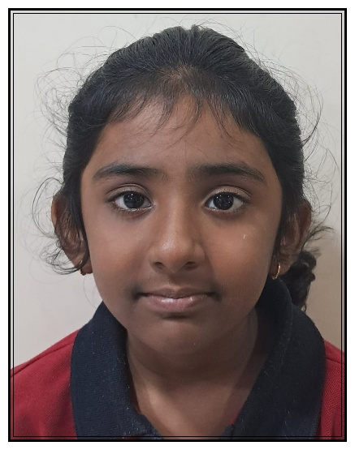
MAHESHWARI PRAGATI MANDAL
MALAD SAMITIES
MALAD UTSAV 2025
⭐⭐⭐⭐⭐
CHAVI GATTANI
⭐⭐⭐⭐⭐
Parent Name: MANOJ & UJWALA GATTANI
School Name: ORCHID THE INTERNATIONAL SCHOOL
Grade Standard: II

Slide 21
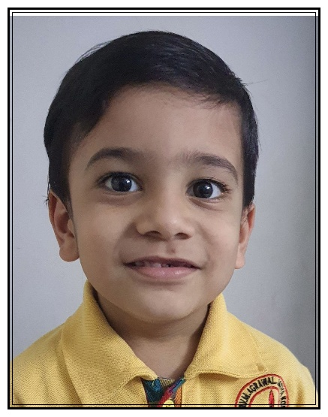
MAHESHWARI PRAGATI MANDAL
MALAD SAMITIES
MALAD UTSAV 2025
⭐⭐⭐⭐⭐
DARSHAN VENKATESH SARDA
⭐⭐⭐⭐⭐
Parent Name: VENKATESH BALKISHAN SARDA
School Name: SJ PODDAR ACADEMY
Grade Standard: II

Slide 22
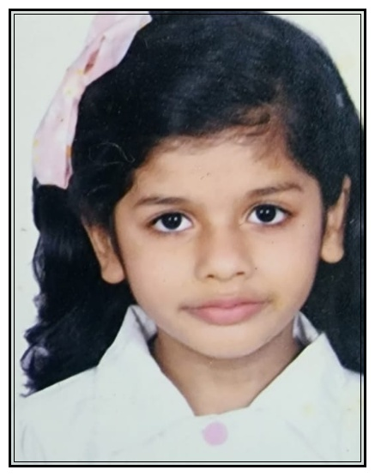
MAHESHWARI PRAGATI MANDAL
MALAD SAMITIES
MALAD UTSAV 2025
⭐⭐⭐⭐⭐
EVANA MAHESHWARI
⭐⭐⭐⭐⭐
Parent Name: BHARAT MANISHA MAHESHWARI
School Name: JBCN INTERNATIONAL
Grade Standard: II

Slide 23
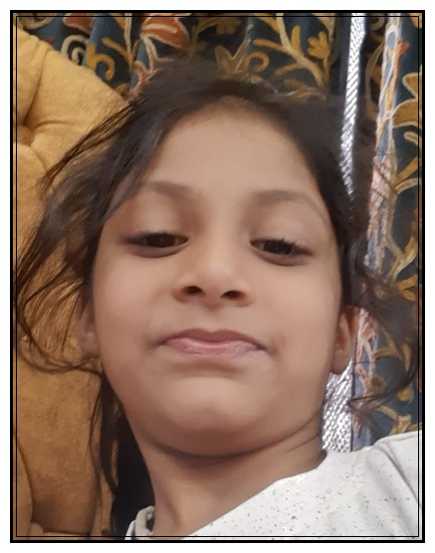
MAHESHWARI PRAGATI MANDAL
MALAD SAMITIES
MALAD UTSAV 2025
⭐⭐⭐⭐⭐
HITIKA GANDHI
⭐⭐⭐⭐⭐
Parent Name: ALEKH GANDHI
School Name: THAKUR INTERNATIONAL SCHOOL
Grade Standard: II

Slide 24
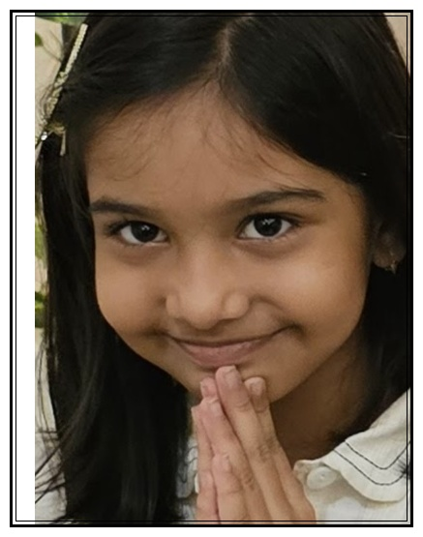
MAHESHWARI PRAGATI MANDAL
MALAD SAMITIES
MALAD UTSAV 2025
⭐⭐⭐⭐⭐
NITAARA DHOOT
⭐⭐⭐⭐⭐
Parent Name: MEGHA DHOOT
School Name: D G KHETAN INTERNATIONAL SCHOOL
Grade Standard: II

Slide 25
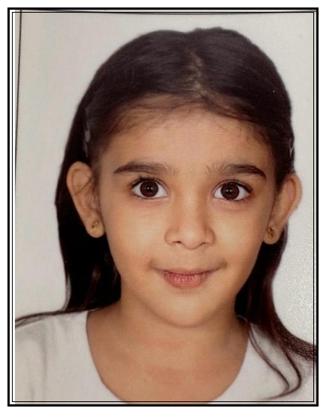
MAHESHWARI PRAGATI MANDAL
MALAD SAMITIES
MALAD UTSAV 2025
⭐⭐⭐⭐⭐
PARISHI MURLI LAHOTI
⭐⭐⭐⭐⭐
Parent Name: MANISHA LAHOTI
School Name: KES INTERNATIONAL SCHOOL
Grade Standard: II

Slide 26
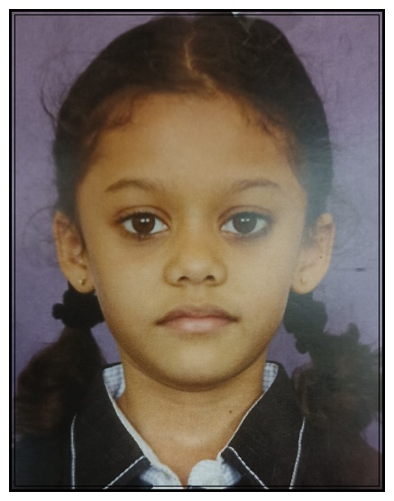
MAHESHWARI PRAGATI MANDAL
MALAD SAMITIES
MALAD UTSAV 2025
⭐⭐⭐⭐⭐
PRISHA SONI
⭐⭐⭐⭐⭐
Parent Name: DHARMENDRA SONI
School Name: PAWAR PUBLIC SCHOOL
Grade Standard: II

Slide 27
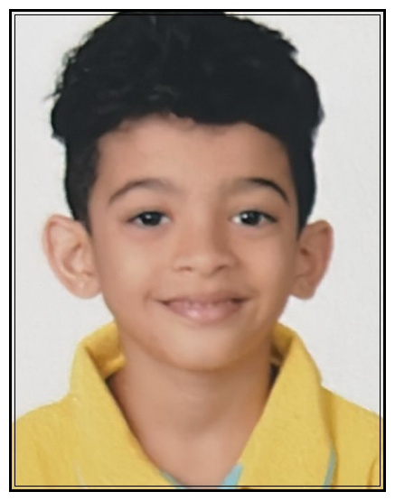
MAHESHWARI PRAGATI MANDAL
MALAD SAMITIES
MALAD UTSAV 2025
⭐⭐⭐⭐⭐
RAGHAV ANUP RATHI
⭐⭐⭐⭐⭐
Parent Name: ANUP MADANMOHAN RATHI
School Name: D G KHETAN INTERNATIONAL SCHOOL
Grade Standard: II

Slide 28
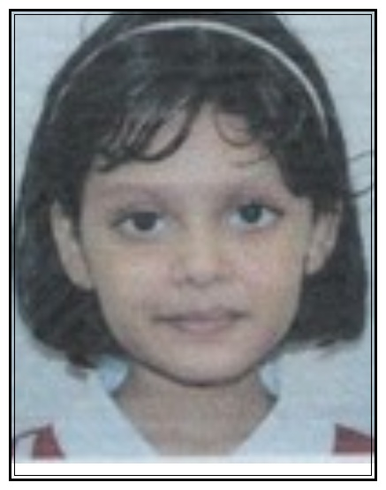
MAHESHWARI PRAGATI MANDAL
MALAD SAMITIES
MALAD UTSAV 2025
⭐⭐⭐⭐⭐
SIA MANDOWARA
⭐⭐⭐⭐⭐
Parent Name: ASHISH MANDOWARA
School Name: VIBGYOR HIGH SCHOOL
Grade Standard: II

Slide 29
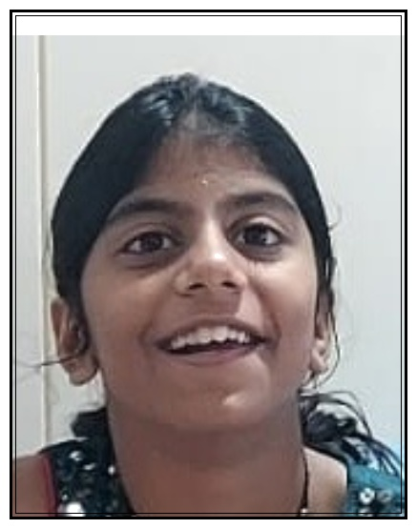
MAHESHWARI PRAGATI MANDAL
MALAD SAMITIES
MALAD UTSAV 2025
⭐⭐⭐⭐⭐
AAHANA ASAWA
⭐⭐⭐⭐⭐
Parent Name: MANISH ASAWA
School Name: CHATRABHUJ NARSEE SCHOOL CNS
Grade Standard: III

Slide 30
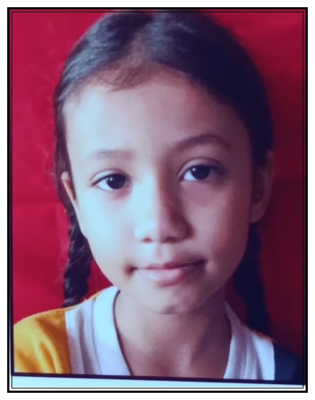
MAHESHWARI PRAGATI MANDAL
MALAD SAMITIES
MALAD UTSAV 2025
⭐⭐⭐⭐⭐
AAHANA AVINASH MANTRI
⭐⭐⭐⭐⭐
Parent Name: AVINASH RAJKUMAR MANTRI
School Name: THAKUR PUBLIC SCHOOL
Grade Standard: III

Slide 31
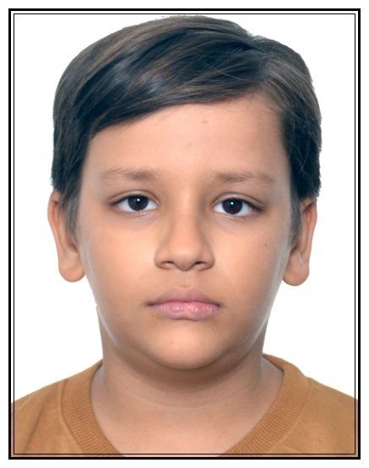
MAHESHWARI PRAGATI MANDAL
MALAD SAMITIES
MALAD UTSAV 2025
⭐⭐⭐⭐⭐
DEVANSH DHOOT
⭐⭐⭐⭐⭐
Parent Name: PRATEEK DHOOT
School Name: VIBGYOR ROOTS AND RISE
Grade Standard: III

Slide 32
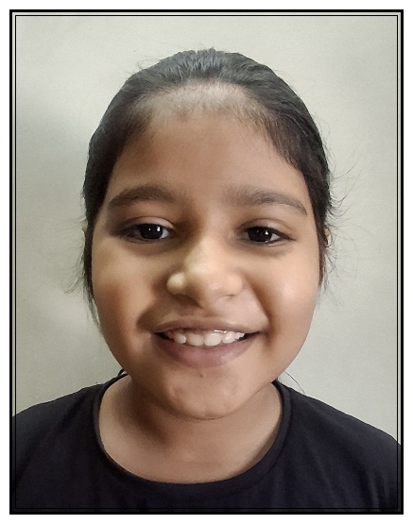
MAHESHWARI PRAGATI MANDAL
MALAD SAMITIES
MALAD UTSAV 2025
⭐⭐⭐⭐⭐
ISHITA MUNDHRA
⭐⭐⭐⭐⭐
Parent Name: PRADEEP MUNDHRA
School Name: ORCHIDS THE INTERNATIONAL SCHOOL
Grade Standard: III

Slide 33
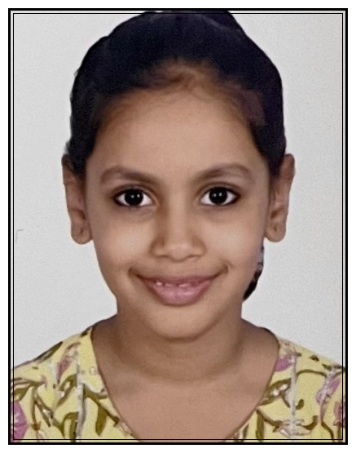
MAHESHWARI PRAGATI MANDAL
MALAD SAMITIES
MALAD UTSAV 2025
⭐⭐⭐⭐⭐
KASHVI MAHESHWARI
⭐⭐⭐⭐⭐
Parent Name: ARUN BALDWA
School Name: GUNDECHA EDUCATION ACADEMY
Grade Standard: III

Slide 34
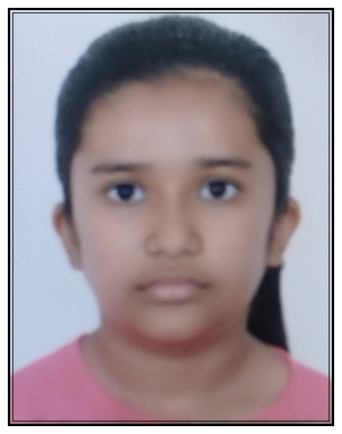
MAHESHWARI PRAGATI MANDAL
MALAD SAMITIES
MALAD UTSAV 2025
⭐⭐⭐⭐⭐
KRISHA KABRA
⭐⭐⭐⭐⭐
Parent Name: VIVEK KABRA
School Name: LOKHANDWALA FOUNDATION SCHOOL
Grade Standard: III

Slide 35
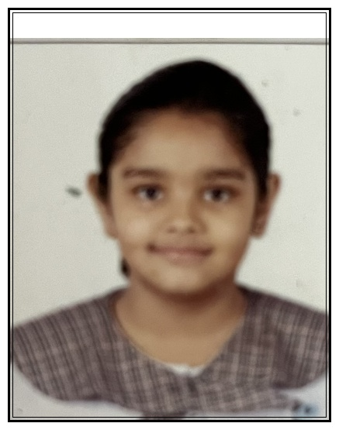
MAHESHWARI PRAGATI MANDAL
MALAD SAMITIES
MALAD UTSAV 2025
⭐⭐⭐⭐⭐
MOKSHI BHATTAR
⭐⭐⭐⭐⭐
Parent Name: RANU BHATTAR
School Name: RAMNIWAS BAJAJ ENGLISH HIGH SCHOOL
Grade Standard: III

Slide 36
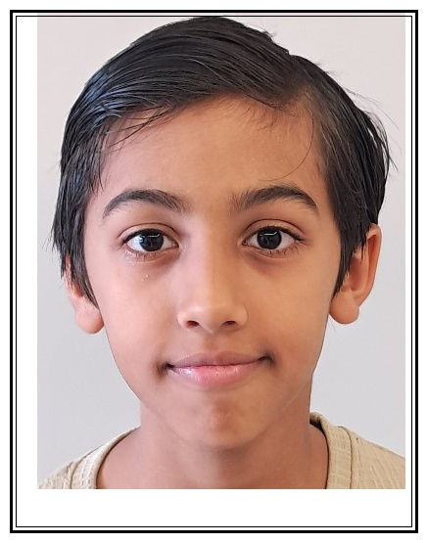
MAHESHWARI PRAGATI MANDAL
MALAD SAMITIES
MALAD UTSAV 2025
⭐⭐⭐⭐⭐
PARTH PARAG BOOB
⭐⭐⭐⭐⭐
Parent Name: PARAG BOOB
School Name: D G KHETAN INTERNATIONAL SCHOOL
Grade Standard: III

Slide 37
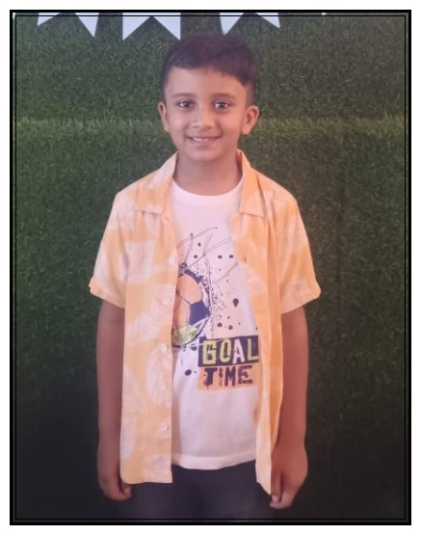
MAHESHWARI PRAGATI MANDAL
MALAD SAMITIES
MALAD UTSAV 2025
⭐⭐⭐⭐⭐
RAKSHIT SOMANI
⭐⭐⭐⭐⭐
Parent Name: SANWARIYA SOMANI
School Name: THAKUR PUBLIC SCHOOL
Grade Standard: III

Slide 38
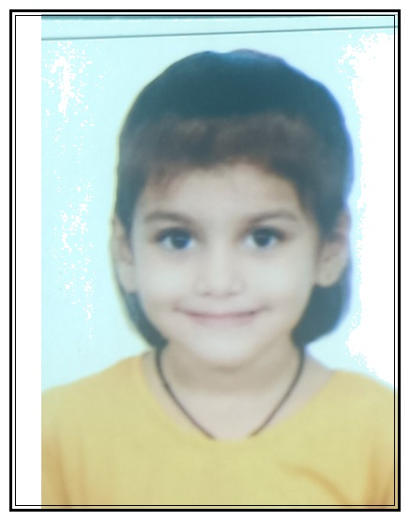
MAHESHWARI PRAGATI MANDAL
MALAD SAMITIES
MALAD UTSAV 2025
⭐⭐⭐⭐⭐
RAYESHA JAJU
⭐⭐⭐⭐⭐
Parent Name: PAWAN JAJU
School Name: UNIVERSAL HIGH SCHOOL ,MALAD EAST
Grade Standard: III

Slide 39
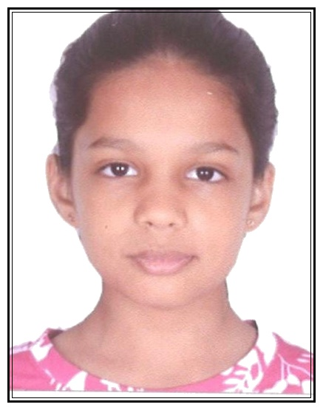
MAHESHWARI PRAGATI MANDAL
MALAD SAMITIES
MALAD UTSAV 2025
⭐⭐⭐⭐⭐
SHREEDA BAHETI
⭐⭐⭐⭐⭐
Parent Name: NANDKISHOR BAHETI
School Name: GUNDECHA EDUCATION ACADEMY
Grade Standard: III

Slide 40
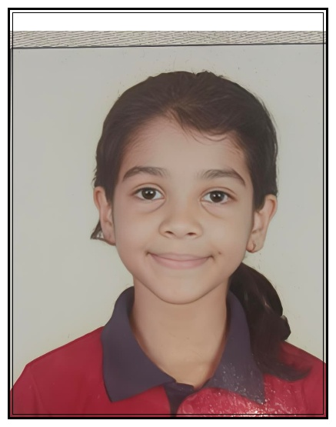
MAHESHWARI PRAGATI MANDAL
MALAD SAMITIES
MALAD UTSAV 2025
⭐⭐⭐⭐⭐
SUMAIRA DHOOT
⭐⭐⭐⭐⭐
Parent Name: SACHIN DHOOT
School Name: ORCHIDS THE INTERNATIONAL SCHOOL
Grade Standard: III

Slide 41
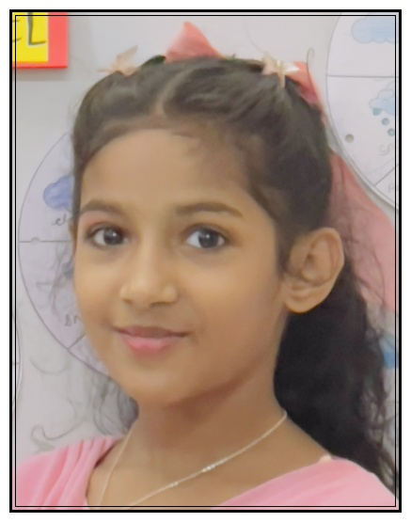
MAHESHWARI PRAGATI MANDAL
MALAD SAMITIES
MALAD UTSAV 2025
⭐⭐⭐⭐⭐
VEDIKA TOSHNIWAL
⭐⭐⭐⭐⭐
Parent Name: MAYURKUMAR TOSHNIWAL
School Name: VIBGYOR ROOTS AND RISE
Grade Standard: III

Slide 42
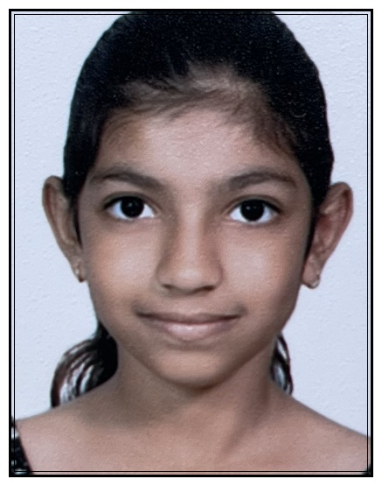
MAHESHWARI PRAGATI MANDAL
MALAD SAMITIES
MALAD UTSAV 2025
⭐⭐⭐⭐⭐
YASHVI SONI
⭐⭐⭐⭐⭐
Parent Name: KALPANA SONI
School Name: WITTY INTERNATIONAL SCHOOL
Grade Standard: III

Slide 43
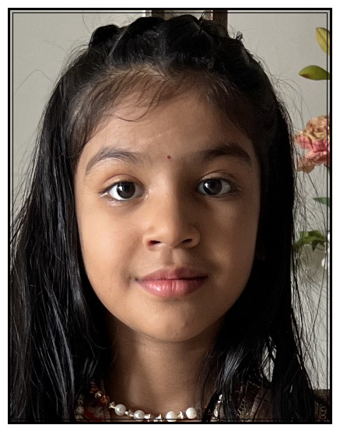
MAHESHWARI PRAGATI MANDAL
MALAD SAMITIES
MALAD UTSAV 2025
⭐⭐⭐⭐⭐
AASHVI BAHETI
⭐⭐⭐⭐⭐
Parent Name: Laxmi Narayan Baheti and Deepika Baheti
School Name: VIBGYOR HIGH SCHOOL
Grade Standard: IV

Slide 44
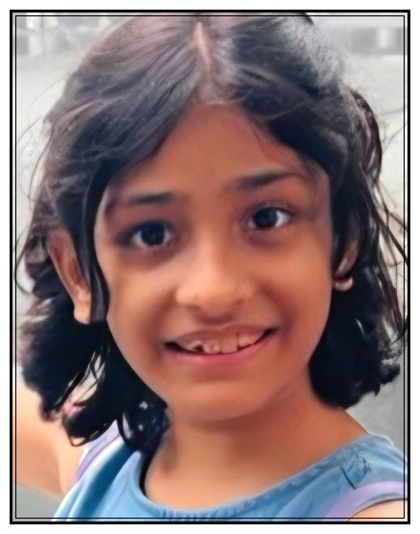
MAHESHWARI PRAGATI MANDAL
MALAD SAMITIES
MALAD UTSAV 2025
⭐⭐⭐⭐⭐
MISHTI KALANTRI
⭐⭐⭐⭐⭐
Parent Name: UMESH KALANTRI
School Name: GUNDECHA EDUCATION ACADEMY
Grade Standard: IV

Slide 45
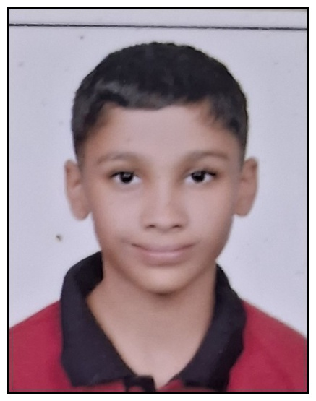
MAHESHWARI PRAGATI MANDAL
MALAD SAMITIES
MALAD UTSAV 2025
⭐⭐⭐⭐⭐
NIVAAN DHOOT
⭐⭐⭐⭐⭐
Parent Name: KUSHAL DHOOT
School Name: ORCHID THE INTERNATIONAL SCHOOL
Grade Standard: IV

Slide 46
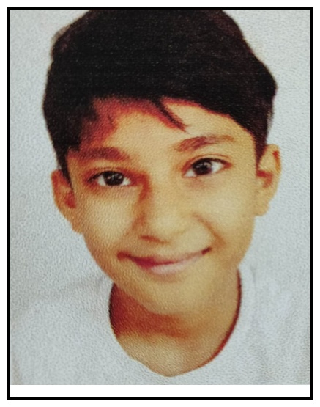
MAHESHWARI PRAGATI MANDAL
MALAD SAMITIES
MALAD UTSAV 2025
⭐⭐⭐⭐⭐
SAMAR SOMANI
⭐⭐⭐⭐⭐
Parent Name: SUMIT SOMANI
School Name: D G KHETAN INTERNATIONAL SCHOOL
Grade Standard: IV

Slide 47
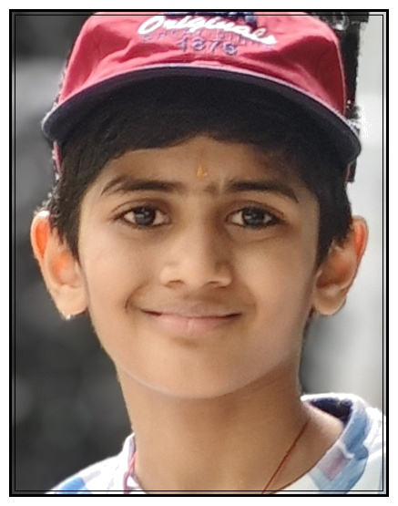
MAHESHWARI PRAGATI MANDAL
MALAD SAMITIES
MALAD UTSAV 2025
⭐⭐⭐⭐⭐
TAVISH RATHI
⭐⭐⭐⭐⭐
Parent Name: VIKAS KUMAR RATHI
School Name: LOKHANDWALA FOUNDATION SCHOOL
Grade Standard: IV

Slide 48
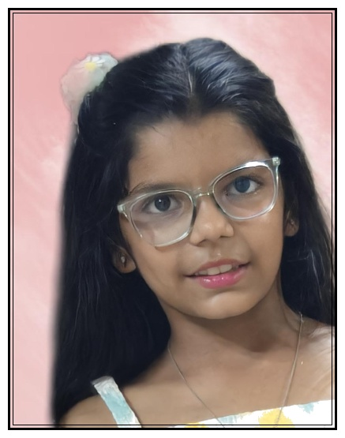
MAHESHWARI PRAGATI MANDAL
MALAD SAMITIES
MALAD UTSAV 2025
⭐⭐⭐⭐⭐
VAANI CHANDAK
⭐⭐⭐⭐⭐
Parent Name: MANMOHAN CHANDAK
School Name: GOKULDHAM HIGH SCHOOL
Grade Standard: IV

Slide 49
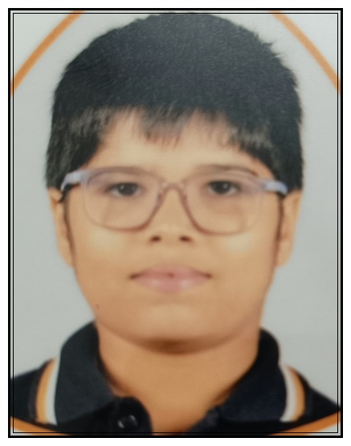
MAHESHWARI PRAGATI MANDAL
MALAD SAMITIES
MALAD UTSAV 2025
⭐⭐⭐⭐⭐
VATSAL MAHESHWARI
⭐⭐⭐⭐⭐
Parent Name: NIKHIL MAHESHWARI
School Name: CHILDREN'S ACADEMY
Grade Standard: IV

Slide 50
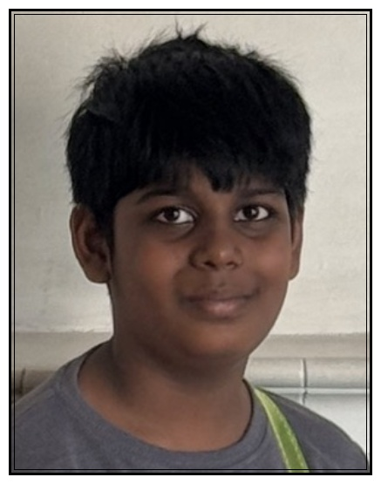
MAHESHWARI PRAGATI MANDAL
MALAD SAMITIES
MALAD UTSAV 2025
⭐⭐⭐⭐⭐
VIRAT JAJOO
⭐⭐⭐⭐⭐
Parent Name: VIKAS JAJOO
School Name: THAKUR PUBLIC SCHOOL
Grade Standard: IV

Slide 51

MAHESHWARI PRAGATI MANDAL
MALAD SAMITIES
MALAD UTSAV 2025
⭐⭐⭐⭐⭐
YAKSH MUNDHRA
⭐⭐⭐⭐⭐
Parent Name: RAMESH MUNDHRA
School Name: ORCHIDS THE INTERNATIONAL SCHOOL
Grade Standard: IV

Slide 52

MAHESHWARI PRAGATI MANDAL
MALAD SAMITIES
MALAD UTSAV 2025
⭐⭐⭐⭐⭐
YUVAAN RATHI
⭐⭐⭐⭐⭐
Parent Name: POOJA RATHI
School Name: WITTY INTERNATIONAL SCHOOL
Grade Standard: IV

Slide 53

MAHESHWARI PRAGATI MANDAL
MALAD SAMITIES
MALAD UTSAV 2025
⭐⭐⭐⭐⭐
AAROHI MOHTA
⭐⭐⭐⭐⭐
Parent Name: GIRIRAJ MOHTA
School Name: VIBGYOR HIGH SCHOOL
Grade Standard: IX

Slide 54

MAHESHWARI PRAGATI MANDAL
MALAD SAMITIES
MALAD UTSAV 2025
⭐⭐⭐⭐⭐
AAYUSHMAN BHALA
⭐⭐⭐⭐⭐
Parent Name: ASHISH BHALA
School Name: LOKHANDWALA FOUNDATION SCHOOL
Grade Standard: IX

Slide 55

MAHESHWARI PRAGATI MANDAL
MALAD SAMITIES
MALAD UTSAV 2025
⭐⭐⭐⭐⭐
BHAVYA BIYANI
⭐⭐⭐⭐⭐
Parent Name: PANKAJ BIYANI
School Name: RAMNIWAS BAJAJ ENGLISH HIGH SCHOOL
Grade Standard: IX

Slide 56

MAHESHWARI PRAGATI MANDAL
MALAD SAMITIES
MALAD UTSAV 2025
⭐⭐⭐⭐⭐
GORAL SOMANI
⭐⭐⭐⭐⭐
Parent Name: GOPAL SOMANI AND ARCHANA SOMANI
School Name: GUNDECHA EDUCATION ACADEMY
Grade Standard: IX

Slide 57

MAHESHWARI PRAGATI MANDAL
MALAD SAMITIES
MALAD UTSAV 2025
⭐⭐⭐⭐⭐
RUDRA RATHI
⭐⭐⭐⭐⭐
Parent Name: NITENDRA RATHI
School Name: CHILDREN'S ACADEMY
Grade Standard: IX

Slide 58

MAHESHWARI PRAGATI MANDAL
MALAD SAMITIES
MALAD UTSAV 2025
⭐⭐⭐⭐⭐
VEDIKA ASAWA
⭐⭐⭐⭐⭐
Parent Name: JAYPRAKASH ASAWA
School Name: RAMNIWAS BAJAJ ENGLISH HIGH SCHOOL
Grade Standard: IX

Slide 59

MAHESHWARI PRAGATI MANDAL
MALAD SAMITIES
MALAD UTSAV 2025
⭐⭐⭐⭐⭐
DRISHTI ASHWIN SONI
⭐⭐⭐⭐⭐
Parent Name: ASHWIN SONI, SHWETA SONI
School Name: D G KHETAN INTERNATIONAL SCHOOL
Grade Standard: V

Slide 60

MAHESHWARI PRAGATI MANDAL
MALAD SAMITIES
MALAD UTSAV 2025
⭐⭐⭐⭐⭐
JASH NARENDRA SONI
⭐⭐⭐⭐⭐
Parent Name: NARENDRA P SONI
School Name: D G KHETAN INTERNATIONAL SCHOOL
Grade Standard: V

Slide 61

MAHESHWARI PRAGATI MANDAL
MALAD SAMITIES
MALAD UTSAV 2025
⭐⭐⭐⭐⭐
MANIT BHUTRA
⭐⭐⭐⭐⭐
Parent Name: VARSHA - SUMIT BHUTRA
School Name: THAKUR PUBLIC SCHOOL
Grade Standard: V

Slide 62

MAHESHWARI PRAGATI MANDAL
MALAD SAMITIES
MALAD UTSAV 2025
⭐⭐⭐⭐⭐
NIRAV BHOOTRA
⭐⭐⭐⭐⭐
Parent Name: HARISH BHOOTRA
School Name: CHILDREN'S ACADEMY
Grade Standard: V

Slide 63

MAHESHWARI PRAGATI MANDAL
MALAD SAMITIES
MALAD UTSAV 2025
⭐⭐⭐⭐⭐
PANKHURI KASAT
⭐⭐⭐⭐⭐
Parent Name: MANISH KASAT
School Name: LOKHANDWALA FOUNDATION SCHOOL
Grade Standard: V

Slide 64

MAHESHWARI PRAGATI MANDAL
MALAD SAMITIES
MALAD UTSAV 2025
⭐⭐⭐⭐⭐
PAVIT HEMANTKUMAR BAHEDIA
⭐⭐⭐⭐⭐
Parent Name: HEMANTKUMAR SHYAMSUNDAR BAHEDIA
School Name: GUNDECHA EDUCATION ACADEMY
Grade Standard: V

Slide 65

MAHESHWARI PRAGATI MANDAL
MALAD SAMITIES
MALAD UTSAV 2025
⭐⭐⭐⭐⭐
RACHIT MOONDRA
⭐⭐⭐⭐⭐
Parent Name: RATISH MOONDRA
School Name: VIBGYOR ROOTS AND RISE
Grade Standard: V

Slide 66

MAHESHWARI PRAGATI MANDAL
MALAD SAMITIES
MALAD UTSAV 2025
⭐⭐⭐⭐⭐
RAGHAV GATTANI
⭐⭐⭐⭐⭐
Parent Name: PUJA GATTANI
School Name: LOKHANDWALA FOUNDATION SCHOOL
Grade Standard: V

Slide 67

MAHESHWARI PRAGATI MANDAL
MALAD SAMITIES
MALAD UTSAV 2025
⭐⭐⭐⭐⭐
SHAURYA KASAT
⭐⭐⭐⭐⭐
Parent Name: MANISH KASAT
School Name: LOKHANDWALA FOUNDATION SCHOOL
Grade Standard: V

Slide 68

MAHESHWARI PRAGATI MANDAL
MALAD SAMITIES
MALAD UTSAV 2025
⭐⭐⭐⭐⭐
TAVISHI KOTHARI
⭐⭐⭐⭐⭐
Parent Name: ABHISHEK KOTHARI
School Name: WITTY INTERNATIONAL SCHOOL
Grade Standard: V

Slide 69

MAHESHWARI PRAGATI MANDAL
MALAD SAMITIES
MALAD UTSAV 2025
⭐⭐⭐⭐⭐
AAHANA DHUPAR
⭐⭐⭐⭐⭐
Parent Name: ASHISH DHUPAR
School Name: LOKHANDWALA FOUNDATION SCHOOL
Grade Standard: VI

Slide 70

MAHESHWARI PRAGATI MANDAL
MALAD SAMITIES
MALAD UTSAV 2025
⭐⭐⭐⭐⭐
KAVISH DAMANI
⭐⭐⭐⭐⭐
Parent Name: PAYAL AND SHASHANK DAMANI
School Name: LOKHANDWALA FOUNDATION SCHOOL
Grade Standard: VI

Slide 71

MAHESHWARI PRAGATI MANDAL
MALAD SAMITIES
MALAD UTSAV 2025
⭐⭐⭐⭐⭐
KAVYA NILESH TAWARI
⭐⭐⭐⭐⭐
Parent Name: NILESH TAWARI
School Name: D G KHETAN INTERNATIONAL SCHOOL
Grade Standard: VI

Slide 72

MAHESHWARI PRAGATI MANDAL
MALAD SAMITIES
MALAD UTSAV 2025
⭐⭐⭐⭐⭐
KAVYA TAPARIA
⭐⭐⭐⭐⭐
Parent Name: PREM TAPARIA
School Name: CHILDREN'S ACADEMY
Grade Standard: VI

Slide 73

MAHESHWARI PRAGATI MANDAL
MALAD SAMITIES
MALAD UTSAV 2025
⭐⭐⭐⭐⭐
KESHAV RATHI
⭐⭐⭐⭐⭐
Parent Name: URMILA ANKIT RATHI
School Name: LAKSHADHAM HIGH SCHOOL
Grade Standard: VI

Slide 74

MAHESHWARI PRAGATI MANDAL
MALAD SAMITIES
MALAD UTSAV 2025
⭐⭐⭐⭐⭐
KRIYANSH RATHI
⭐⭐⭐⭐⭐
Parent Name: SHWETA RATHI
School Name: GUNDECHA EDUCATION ACADEMY
Grade Standard: VI

Slide 75

MAHESHWARI PRAGATI MANDAL
MALAD SAMITIES
MALAD UTSAV 2025
⭐⭐⭐⭐⭐
PRACHITA SINGHI
⭐⭐⭐⭐⭐
Parent Name: PRIYANKA SINGHI
School Name: CHILDREN'S ACADEMY
Grade Standard: VI

Slide 76

MAHESHWARI PRAGATI MANDAL
MALAD SAMITIES
MALAD UTSAV 2025
⭐⭐⭐⭐⭐
RHEA SATISH KALANTRI
⭐⭐⭐⭐⭐
Parent Name: SATISH PURUSHOTTAM KALANTRI
School Name: THAKUR PUBLIC SCHOOL
Grade Standard: VI

Slide 77

MAHESHWARI PRAGATI MANDAL
MALAD SAMITIES
MALAD UTSAV 2025
⭐⭐⭐⭐⭐
RIDDHAM NAWAL
⭐⭐⭐⭐⭐
Parent Name: MONA DEEPAK NAWAL
School Name: VIBGYOR HIGH SCHOOL
Grade Standard: VI

Slide 78

MAHESHWARI PRAGATI MANDAL
MALAD SAMITIES
MALAD UTSAV 2025
⭐⭐⭐⭐⭐
RIDDHIMA NAWAL
⭐⭐⭐⭐⭐
Parent Name: MONA DEEPAK NAWAL
School Name: VIBGYOR HIGH SCHOOL
Grade Standard: VI

Slide 79

MAHESHWARI PRAGATI MANDAL
MALAD SAMITIES
MALAD UTSAV 2025
⭐⭐⭐⭐⭐
RIDHIMA PANSARI
⭐⭐⭐⭐⭐
Parent Name: VISHAL PANSARI
School Name: VIBGYOR HIGH SCHOOL
Grade Standard: VI

Slide 80

MAHESHWARI PRAGATI MANDAL
MALAD SAMITIES
MALAD UTSAV 2025
⭐⭐⭐⭐⭐
SHREYA KANKANI
⭐⭐⭐⭐⭐
Parent Name: RAMANUJ C KANKANI
School Name: ASPEE NUTAN ACADEMY
Grade Standard: VI

Slide 81

MAHESHWARI PRAGATI MANDAL
MALAD SAMITIES
MALAD UTSAV 2025
⭐⭐⭐⭐⭐
TAVISHA BIYANI
⭐⭐⭐⭐⭐
Parent Name: CHHAYA BIYANI
School Name: CHILDRENS ACADEMY, ASHOK NAGAR
Grade Standard: VI

Slide 82

MAHESHWARI PRAGATI MANDAL
MALAD SAMITIES
MALAD UTSAV 2025
⭐⭐⭐⭐⭐
VIHAN DAGA
⭐⭐⭐⭐⭐
Parent Name: ADITYA DAGA
School Name: GUNDECHA EDUCATION ACADEMY
Grade Standard: VI

Slide 83

MAHESHWARI PRAGATI MANDAL
MALAD SAMITIES
MALAD UTSAV 2025
⭐⭐⭐⭐⭐
VRINDA MUNDHRA
⭐⭐⭐⭐⭐
Parent Name: RAMESH MUNDHRA
School Name: ORCHID THE INTERNATIONAL SCHOOL
Grade Standard: VI

Slide 84

MAHESHWARI PRAGATI MANDAL
MALAD SAMITIES
MALAD UTSAV 2025
⭐⭐⭐⭐⭐
DARSH SAWNA
⭐⭐⭐⭐⭐
Parent Name: JAISHREE SAWNA
School Name: LAKSHADHAM HIGH SCHOOL
Grade Standard: VII

Slide 85

MAHESHWARI PRAGATI MANDAL
MALAD SAMITIES
MALAD UTSAV 2025
⭐⭐⭐⭐⭐
DARSH VIKAS RATHI
⭐⭐⭐⭐⭐
Parent Name: VIKAS RATHI
School Name: VIBGYOR ROOTS AND RISE
Grade Standard: VII

Slide 86

MAHESHWARI PRAGATI MANDAL
MALAD SAMITIES
MALAD UTSAV 2025
⭐⭐⭐⭐⭐
DEHUTI BHAIYYA
⭐⭐⭐⭐⭐
Parent Name: ASHISH POONAM BHAIYYA
School Name: ST. JOHN UNIVERSAL SCHOOL
Grade Standard: VII

Slide 87

MAHESHWARI PRAGATI MANDAL
MALAD SAMITIES
MALAD UTSAV 2025
⭐⭐⭐⭐⭐
MISHIKA BIYANI
⭐⭐⭐⭐⭐
Parent Name: PRADEEP BIYANI
School Name: WITTY INTERNATIONAL SCHOOL
Grade Standard: VII

Slide 88

MAHESHWARI PRAGATI MANDAL
MALAD SAMITIES
MALAD UTSAV 2025
⭐⭐⭐⭐⭐
RUTVI BHUTRA
⭐⭐⭐⭐⭐
Parent Name: VARSHA BHUTRA - SUMIT BHUTRA
School Name: THAKUR PUBLIC SCHOOL
Grade Standard: VII

Slide 89

MAHESHWARI PRAGATI MANDAL
MALAD SAMITIES
MALAD UTSAV 2025
⭐⭐⭐⭐⭐
SHIVANSH RATHI
⭐⭐⭐⭐⭐
Parent Name: VISHNU RATHI
School Name: WITTY INTERNATIONAL SCHOOL
Grade Standard: VII

Slide 90

MAHESHWARI PRAGATI MANDAL
MALAD SAMITIES
MALAD UTSAV 2025
⭐⭐⭐⭐⭐
SHREYANSH MALPANI
⭐⭐⭐⭐⭐
Parent Name: NATVARLAL MALPANI
School Name: SWAMI VIVEKANAND INTERNATIONAL SCHOOL
Grade Standard: VII

Slide 91

MAHESHWARI PRAGATI MANDAL
MALAD SAMITIES
MALAD UTSAV 2025
⭐⭐⭐⭐⭐
VANSHIKA KABRA
⭐⭐⭐⭐⭐
Parent Name: ARTI KABRA
School Name: THAKUR INTERNATIONAL SCHOOL
Grade Standard: VII

Slide 92

MAHESHWARI PRAGATI MANDAL
MALAD SAMITIES
MALAD UTSAV 2025
⭐⭐⭐⭐⭐
VIHAAN LOHIA
⭐⭐⭐⭐⭐
Parent Name: DITI LOHIA
School Name: PAWAR PUBLIC SCHOOL
Grade Standard: VII

Slide 93

MAHESHWARI PRAGATI MANDAL
MALAD SAMITIES
MALAD UTSAV 2025
⭐⭐⭐⭐⭐
VIVAAN BAHETI
⭐⭐⭐⭐⭐
Parent Name: NANDKISHOR BAHRTI
School Name: GUNDECHA EDUCATION ACADEMY
Grade Standard: VII

Slide 94

MAHESHWARI PRAGATI MANDAL
MALAD SAMITIES
MALAD UTSAV 2025
⭐⭐⭐⭐⭐
AAROH GANDHI
⭐⭐⭐⭐⭐
Parent Name: ALEKH GANDHI
School Name: BHONSALA MILIITARY SCHOOL NASHIK
Grade Standard: VIII

Slide 95

MAHESHWARI PRAGATI MANDAL
MALAD SAMITIES
MALAD UTSAV 2025
⭐⭐⭐⭐⭐
ADVAIT CHAUDHARY (KAKANI)
⭐⭐⭐⭐⭐
Parent Name: ANAND CHAUDHARY (KAKANI RAMSAR WALE)
School Name: HILLSBOROUGH MIDDLE SCHOOL
Grade Standard: VIII

Slide 96

MAHESHWARI PRAGATI MANDAL
MALAD SAMITIES
MALAD UTSAV 2025
⭐⭐⭐⭐⭐
AKSHITA RAHUL ASSAWA
⭐⭐⭐⭐⭐
Parent Name: RAHUL & SUCHIKA ASSAWA
School Name: D G KHETAN INTERNATIONAL SCHOOL
Grade Standard: VIII

Slide 97

MAHESHWARI PRAGATI MANDAL
MALAD SAMITIES
MALAD UTSAV 2025
⭐⭐⭐⭐⭐
AYUSHI RAJESH BIRLA
⭐⭐⭐⭐⭐
Parent Name: RAJESH BALKISHAN BIRLA
School Name: KAPOL VIDYANIDHI INTERNATIONAL SCHOOL
Grade Standard: VIII

Slide 98

MAHESHWARI PRAGATI MANDAL
MALAD SAMITIES
MALAD UTSAV 2025
⭐⭐⭐⭐⭐
DEVANSH BAHETI
⭐⭐⭐⭐⭐
Parent Name: Laxmi Narayan Baheti
School Name: VIBGYOR HIGH SCHOOL
Grade Standard: VIII

Slide 99

MAHESHWARI PRAGATI MANDAL
MALAD SAMITIES
MALAD UTSAV 2025
⭐⭐⭐⭐⭐
DIYA GAGGAR
⭐⭐⭐⭐⭐
Parent Name: DEEPALI AND RAMAVTAR GAGGAR
School Name: VIBGYOR ROOTS AND RISE
Grade Standard: VIII

Slide 100
MAHESHWARI PRAGATI MANDAL
MALAD SAMITIES
MALAD UTSAV 2025
⭐⭐⭐⭐⭐
HARSH GAGGAR
⭐⭐⭐⭐⭐
Parent Name: NEETA AND KAILASH KUMAR GAGGAR
School Name: INDIAN LANGUAGE SCHOOL, LAGOS, NIGERIA
Grade Standard: VIII

Slide 101

MAHESHWARI PRAGATI MANDAL
MALAD SAMITIES
MALAD UTSAV 2025
⭐⭐⭐⭐⭐
JIYA KALANTRI
⭐⭐⭐⭐⭐
Parent Name: UMESH KALANTRI
School Name: GUNDECHA EDUCATION ACADEMY
Grade Standard: VIII

Slide 102

MAHESHWARI PRAGATI MANDAL
MALAD SAMITIES
MALAD UTSAV 2025
⭐⭐⭐⭐⭐
KHUSH DHOOT
⭐⭐⭐⭐⭐
Parent Name: SACHIN DHOOT
School Name: ORCHIDS THE INTERNATIONAL SCHOOL
Grade Standard: VIII

Slide 103

MAHESHWARI PRAGATI MANDAL
MALAD SAMITIES
MALAD UTSAV 2025
⭐⭐⭐⭐⭐
SHRIYA DAMANI
⭐⭐⭐⭐⭐
Parent Name: PAYAL AND SHASHANK DAMANI
School Name: LOKHANDWALA FOUNDATION SCHOOL
Grade Standard: VIII

Slide 104

MAHESHWARI PRAGATI MANDAL
MALAD SAMITIES
MALAD UTSAV 2025
⭐⭐⭐⭐⭐
THWISHA RAVINDRA BANG
⭐⭐⭐⭐⭐
Parent Name: RAVINDRA PURUSHOTTAM BANG
School Name: SWAMI VIVEKANAND INTERNATIONAL SCHOOL
Grade Standard: VIII

Slide 105

MAHESHWARI PRAGATI MANDAL
MALAD SAMITIES
MALAD UTSAV 2025
⭐⭐⭐⭐⭐
YAJAT CHANDAK
⭐⭐⭐⭐⭐
Parent Name: NIKHIL CHANDAK
School Name: GOKULDHAM HIGH SCHOOL
Grade Standard: VIII

Slide 106

MAHESHWARI PRAGATI MANDAL
MALAD SAMITIES
MALAD UTSAV 2025
⭐⭐⭐⭐⭐
BHAVYA MAHENDRA RATHI
⭐⭐⭐⭐⭐
Parent Name: MAHENDRA RAMNARAYAN RATHI
School Name: KAPOL VIDYANIDHI INTERNATIONAL SCHOOL
Grade Standard: X

Slide 107

MAHESHWARI PRAGATI MANDAL
MALAD SAMITIES
MALAD UTSAV 2025
⭐⭐⭐⭐⭐
CHAITANYA MUNDRA
⭐⭐⭐⭐⭐
Parent Name: RAMESH AND JYOTI MUNDRA
School Name: THAKUR PUBLIC SCHOOL
Grade Standard: X

Slide 108

MAHESHWARI PRAGATI MANDAL
MALAD SAMITIES
MALAD UTSAV 2025
⭐⭐⭐⭐⭐
DHRUV KABRA
⭐⭐⭐⭐⭐
Parent Name: SURENDRA KABRA
School Name: BILLABONG HIGH INTERNATIONAL SCHOOL
Grade Standard: X

Slide 109

MAHESHWARI PRAGATI MANDAL
MALAD SAMITIES
MALAD UTSAV 2025
⭐⭐⭐⭐⭐
HIYA MAHENDRA RATHI
⭐⭐⭐⭐⭐
Parent Name: MAHENDRA MADANMOHAN RATHI
School Name: GOKULDHAM HIGH SCHOOL
Grade Standard: X

Slide 110

MAHESHWARI PRAGATI MANDAL
MALAD SAMITIES
MALAD UTSAV 2025
⭐⭐⭐⭐⭐
JAI TOSHNIWAL
⭐⭐⭐⭐⭐
Parent Name: MEENA TOSHNIWAL
School Name: GUNDECHA EDUCATION ACADEMY
Grade Standard: X

Slide 111

MAHESHWARI PRAGATI MANDAL
MALAD SAMITIES
MALAD UTSAV 2025
⭐⭐⭐⭐⭐
MADHAV JHAWAR
⭐⭐⭐⭐⭐
Parent Name: AJAY JHANWAR
School Name: GUNDECHA EDUCATION ACADEMY
Grade Standard: X

Slide 112

MAHESHWARI PRAGATI MANDAL
MALAD SAMITIES
MALAD UTSAV 2025
⭐⭐⭐⭐⭐
NARAYAN ANIL ASAWA
⭐⭐⭐⭐⭐
Parent Name: ANIL ASAWA
School Name: RAMNIWAS BAJAJ ENGLISH HIGH SCHOOL
Grade Standard: X

Slide 113

MAHESHWARI PRAGATI MANDAL
MALAD SAMITIES
MALAD UTSAV 2025
⭐⭐⭐⭐⭐
RISHIT MAHESHWARI
⭐⭐⭐⭐⭐
Parent Name: HARISH MAHESHWARI
School Name: LOKHANDWALA FOUNDATION SCHOOL
Grade Standard: X

Slide 114

MAHESHWARI PRAGATI MANDAL
MALAD SAMITIES
MALAD UTSAV 2025
⭐⭐⭐⭐⭐
SANSKRITI PUGALIA
⭐⭐⭐⭐⭐
Parent Name: ASHISH PUGALIA
School Name: THAKUR INTERNATIONAL SCHOOL
Grade Standard: X

Slide 115

MAHESHWARI PRAGATI MANDAL
MALAD SAMITIES
MALAD UTSAV 2025
⭐⭐⭐⭐⭐
TANISI MADHUSUDAN SARDA
⭐⭐⭐⭐⭐
Parent Name: MADHUSUDAN N SARDA
School Name: VIBGYOR HIGH SCHOOL
Grade Standard: X

Slide 116

MAHESHWARI PRAGATI MANDAL
MALAD SAMITIES
MALAD UTSAV 2025
⭐⭐⭐⭐⭐
VEDIKA VISHNU TOSHNIWAL
⭐⭐⭐⭐⭐
Parent Name: VISHNU SATYANARAYAN TOSHNIWAL
School Name: SHREE BALAJI INTERNATIONAL SCHOOL
Grade Standard: X

Slide 117

MAHESHWARI PRAGATI MANDAL
MALAD SAMITIES
MALAD UTSAV 2025
⭐⭐⭐⭐⭐
YASH MALANI
⭐⭐⭐⭐⭐
Parent Name: NILESH MALANI
School Name: THAKUR INTERNATIONAL SCHOOL
Grade Standard: X

